Slide 1
TAS and STAGE 5 VET Hospitality Certificate I
Yr. 9 IT Metal | Yr. 10 IT Metal
Yr. 9 IT Timber | Yr.10 IT Timber
Yr. 9 Food Technology | Yr.10 Certificate I in Hospitality

Slide 2
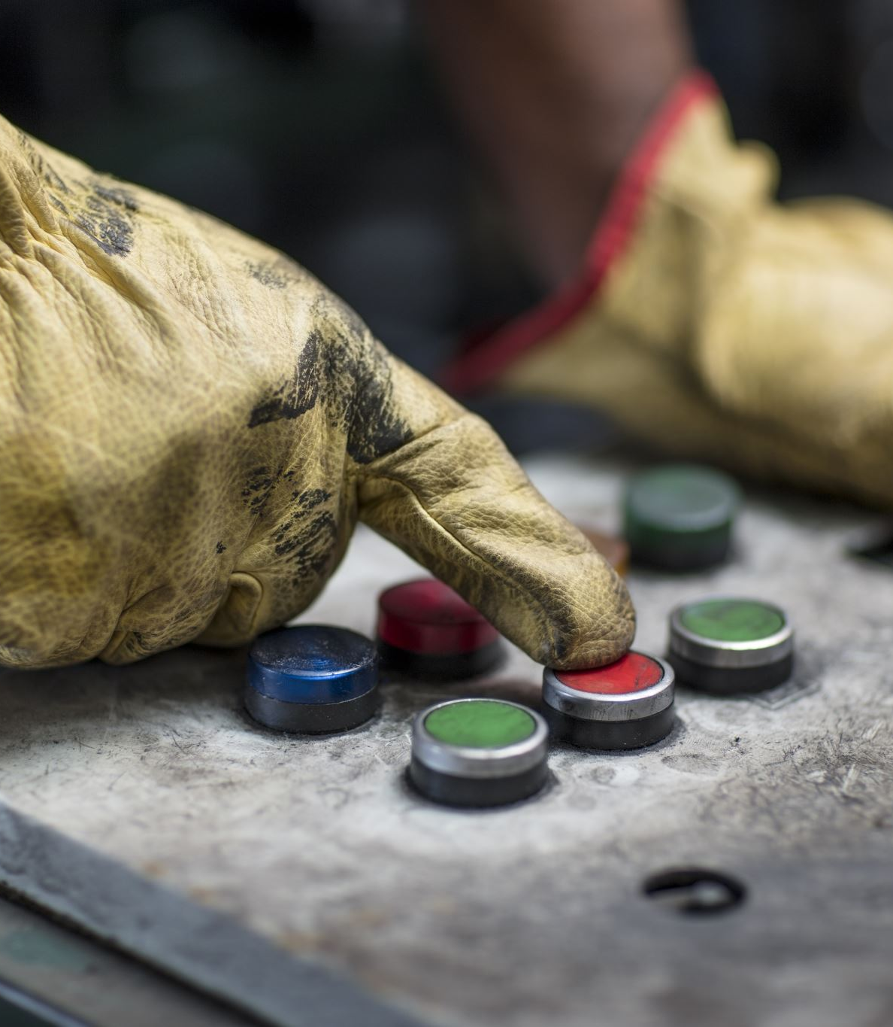
INDUSTRIAL TECHNOLOGY – Metal
The Metal course provides opportunities for students to develop knowledge, understanding and skills in relation to Metal and associated industries. The students will develop knowledge and skills in the use of materials, tools and techniques related to metal material repair and maintenance.

Slide 3
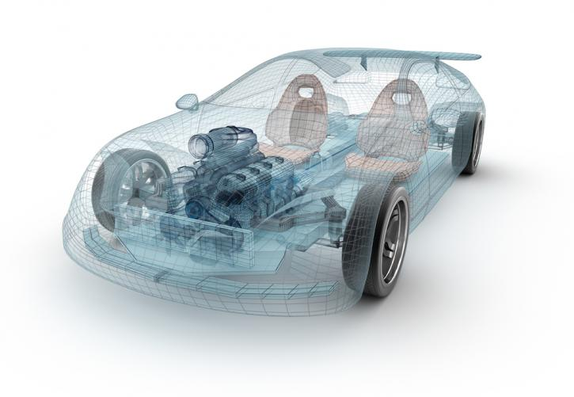
.
INDUSTRIAL TECHNOLOGY – Metal
Neat personal appearance
Good communication skills
Good memory
Polite and patient
Friendly and efficient
Enjoy working with people
Able to work as part of a team
This can also lead to School Based Apprenticeship & Traineeship (SBAT) in Yrs.11 & 12 and full time Apprenticeship opportunities after school for you.

Slide 4
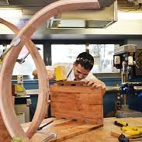
INDUSTRIAL TECHNOLOGY – TIMBER
General Wood, Wood Machining and Cabinet-Work.
This course serves as an introduction to basic skills in the wood industry.
Students will actively participate in manufacturing a range of products which are wood material based.
This course revolves around a practical approach to student centred learning.
Design and planning procedures will be developed enabling students to specialise in an area of study within Wood Machining, Cabinet-work and General Wood.
Students who have exhibited a sound understanding of their specialised areas will be permitted to undertake a personalised major project.

Slide 5
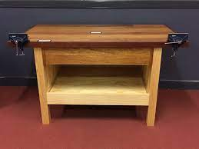
INDUSTRIAL TECHNOLOGY – TIMBER
Enjoy practical work
Able to work with your hands
Good sense of balance
Good at Mathematics
Able to work as part of a team
This can also lead to School Based Apprenticeship & Traineeship (SBAT) in Yrs.11 & 12 and full time Apprenticeship opportunities after school for you.

Slide 6
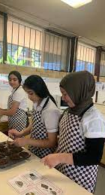
Yr. 9 FOOD TECHNOLOGY
In the Food Technology course, students will study the domestic, commercial and industrial applications of food technologies and food preparation. It involves students investigating foods through practical ‘hands on’ applications such as food preparation and presentation. Students will gain knowledge in processes such as designing, researching, making, communicating and managing. It provides opportunities for students to evaluate the impact of food technologies on the individual, society and the environment.

Slide 7
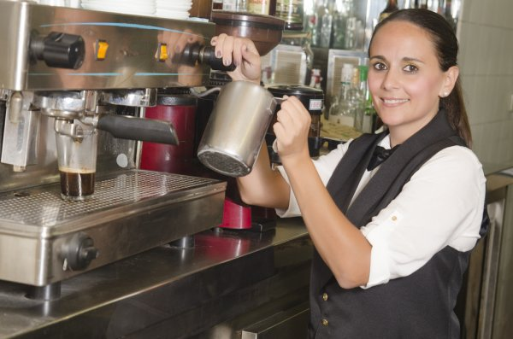
Yr.10 Certificate I in Hospitality
Neat personal appearance
A high level of personal hygiene
Good communication skills
Good memory
Polite and patient
Friendly and efficient
Enjoy working with people
Able to work as part of a team
This can also lead to School Based Apprenticeship & Traineeship (SBAT) in Yrs.11 & 12 and full time Apprenticeship opportunities after school for you.
.

